Slide 1


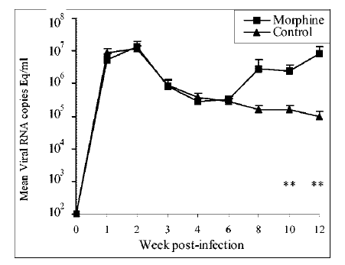
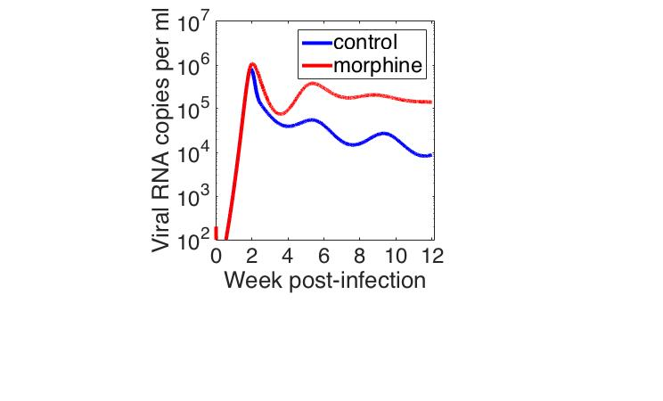
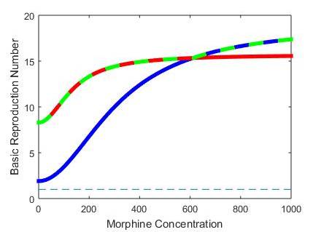
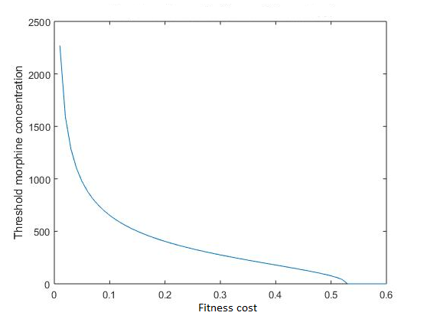
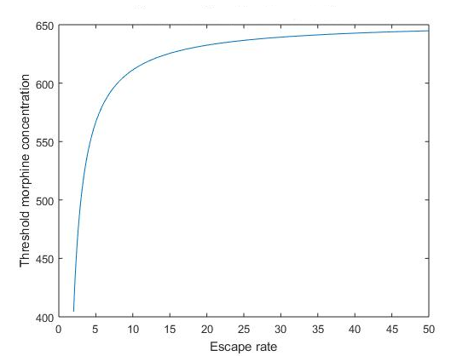
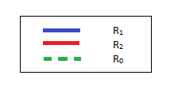
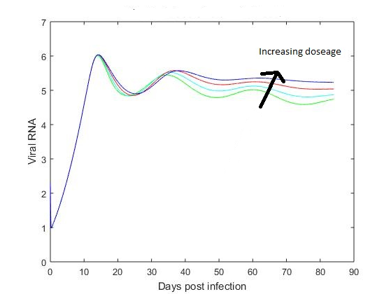
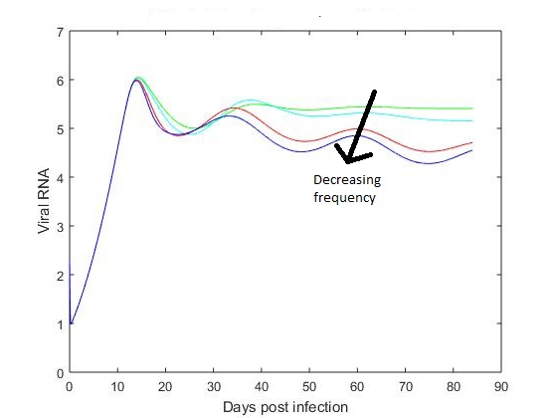
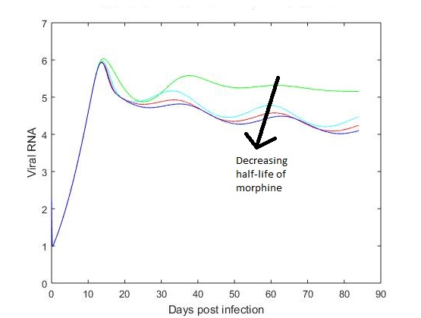










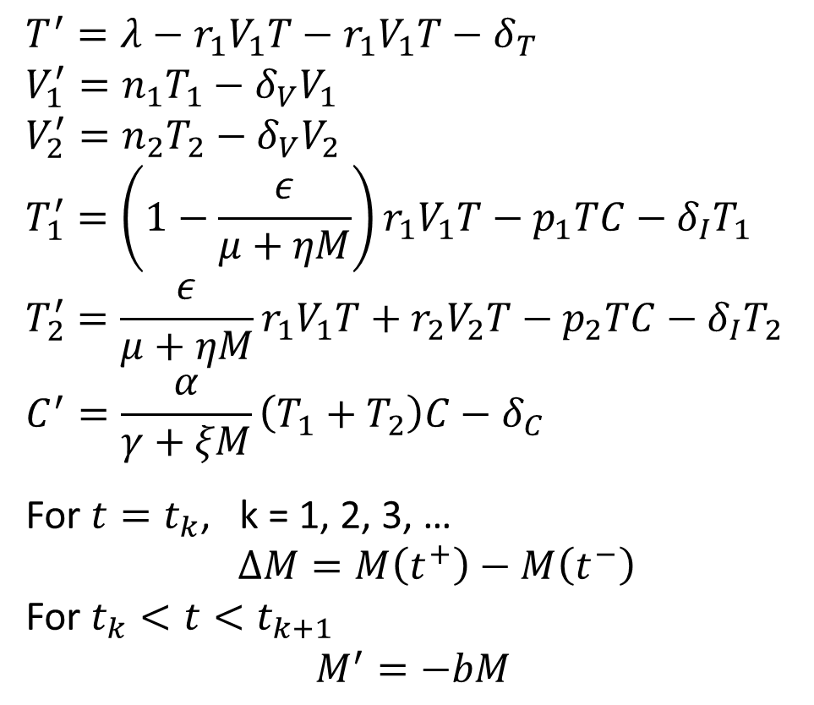




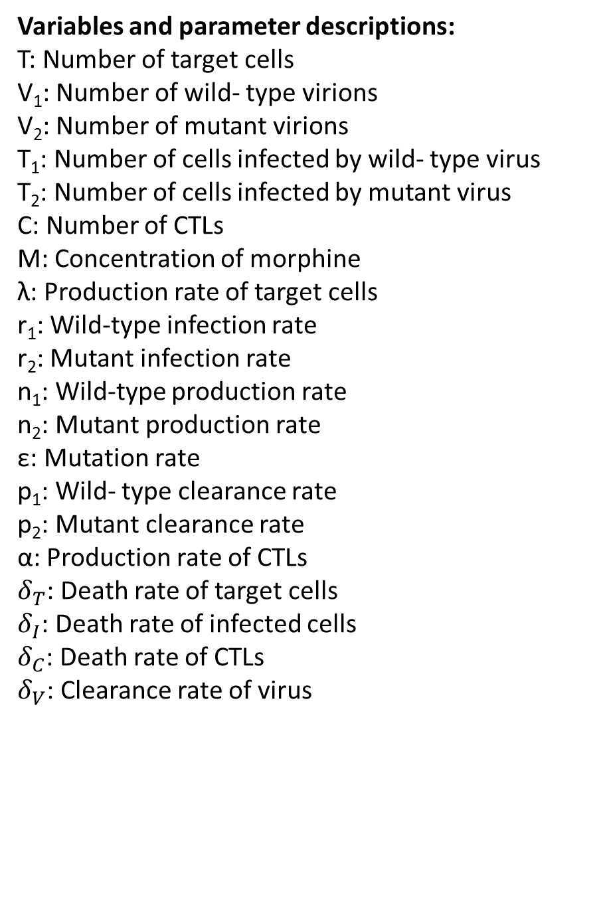

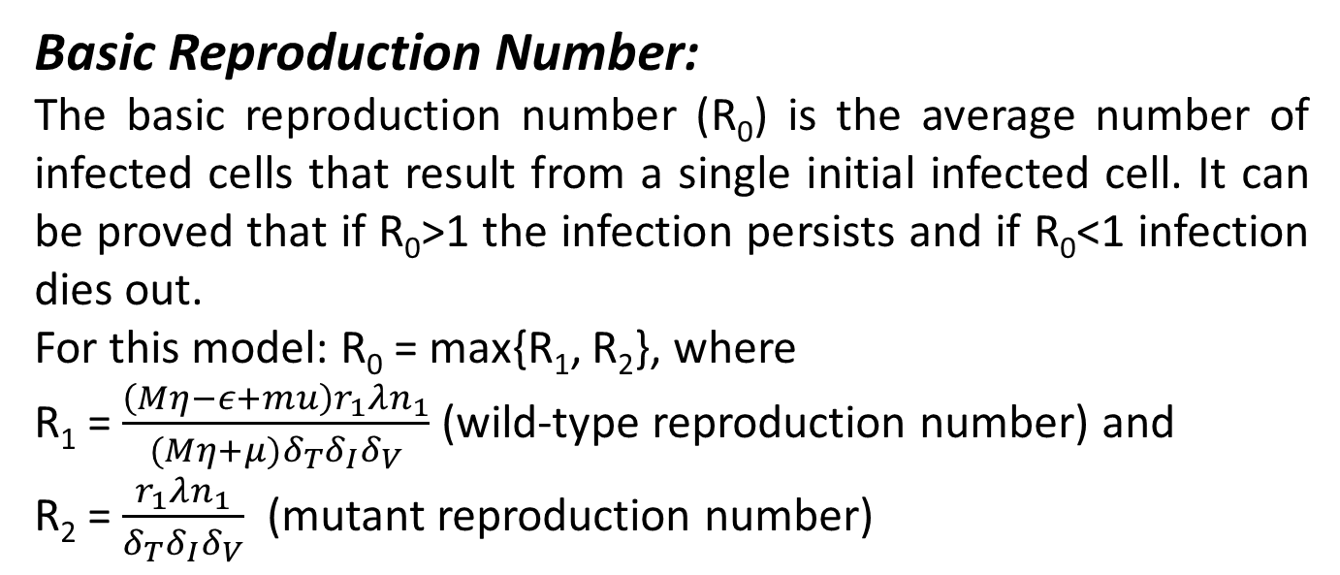
Department of Mathematics and Statistics
Modeling the dynamics of wild type and mutant HIV strains in the presence of morphine
Peter Uhl¹, Anil Kumar², and Naveen K. Vaidya^{1,2}
¹Department of Mathematics and Statistics and ²School of Pharmacy, University of Missouri – Kansas City
Abstract
Background
Mathematical Model
Injection drug use is one of the greatest risk factors associated with contracting human immunodeficiency virus (HIV), and drug abusers infected with HIV suffer from a higher viral load and rapid pathogenesis. Replication of HIV results in a large number of mutant viruses that can escape recognition of the host’s immune response. Studies have also shown that the presence of morphine decreases the virus mutation rate and diminishes the cellular immune response. In this study, we developed a mathematical model to determine if the decrease in mutation and cellular immune response in the presence of morphine can account for the increased viral load. We found that the morphine-altered mutation rate and cellular immune response can favor the wild-type virus and allow it to out compete the mutant, resulting in a higher viral load. We performed analytical techniques on this model in order to calculate the basic reproduction number (R₀) of the sensitive and mutant viruses, and identified the threshold concentration of morphine for the mutant virus to dominate. We also studied how the pharmacokinetic and pharmacodynamic properties of morphine such as decay rate and frequency and size of the morphine dose affects the viral dynamics. Our results show that morphine can have a significant impact on the dynamics of the wild type and mutant viruses as well as cause the viral population to switch, thereby having a significant impact on the viral load and pathogenesis.
Drugs of abuse, including injection drugs, are widespread amongst people infected with HIV and the use of such drugs has been shown to significantly increase the viral load, pathogeneses, and HIV-associated Neurological Disorder (HAND) in infected individuals. Morphine, the active compound in heroin, is of particular interest because of its effect om the progression of HIV infections. Therefore, it is important to study the effects of morphine on HIV infections.
λ
$$δ_{T}$$
$$T^{′}=λ−r_{1}V_{1}T−r_{1}V_{1}T−δ_{T}$$
$$V_{1}^{′}=n_{1}T_{1}−δ_{V}V_{1}$$
$$V_{2}^{′}=n_{2}T_{2}−δ_{V}V_{2}$$
$$T_{1}^{′}=\left(1−\frac{ε}{μ+ηM}\right)r_{1}V_{1}T−p_{1}TC−δ_{I}T_{1}$$
$$T_{2}^{′}=\frac{ε}{μ+ηM}r_{1}V_{1}T+r_{2}V_{2}T−p_{2}TC−δ_{I}T_{2}$$
$$C^{′}=\frac{α}{γ+ξM}\left(T_{1}+T_{2}\right)C−δ_{C}$$
For $t=t_{k}$, k = 1, 2, 3, …
$∆M=M\left(t^{+}\right)−M\left(t^{−}\right)$
For $t_{k}<t<t_{k+1}$
$$M^{′}=−bM$$
T
$$\left(1−\frac{ε}{μ+ηM}\right)r_{1}$$
$$\frac{ε}{μ+ηM}r_{1}$$
$$r_{2}$$
$$δ_{I}$$
T₁
T₂
$$δ_{I}$$
Experimental Evidence
$$p_{1}$$
$$\frac{α}{γ+ξM}$$
$$p_{2}$$
Variables and parameter descriptions:
T: Number of target cells
V₁: Number of wild- type virions
V₂: Number of mutant virions
T₁: Number of cells infected by wild- type virus
T₂: Number of cells infected by mutant virus
C: Number of CTLs
M: Concentration of morphine
λ: Production rate of target cells
r₁: Wild-type infection rate
r₂: Mutant infection rate
n₁: Wild-type production rate
n₂: Mutant production rate
ε: Mutation rate
p₁: Wild- type clearance rate
p₂: Mutant clearance rate
α: Production rate of CTLs
$δ_{T}$: Death rate of target cells
$δ_{I}$: Death rate of infected cells
$δ_{C}$: Death rate of CTLs
$δ_{V}$: Clearance rate of virus
Drugs of abuse
Increases viral load
Increases pathogenesis
Morphine Conditioning
Lowers cellular immune responses
Lowers the amount of mutations
$$n_{1}$$
$$n_{2}$$
$$\frac{α}{γ+ξM}$$
V₁
V₂
Research Question
Can the lowered immune response and mutation caused by the use of morphine account for the increased viral load?
$$δ_{V}$$
C
$$δ_{V}$$
$$δ_{C}$$
Results
Model Validation:
Basic Reproduction Number:
The basic reproduction number (R₀) is the average number of infected cells that result from a single initial infected cell. It can be proved that if R₀>1 the infection persists and if R₀<1 infection dies out.
For this model: R₀ = max{R₁, R₂}, where
R₁ = $\frac{\left(Mη−ε+mu\right)r_{1}λn_{1}}{(Mη+μ)δ_{T}δ_{I}δ_{V}}$ (wild-type reproduction number) and
R₂ = $\frac{r_{1}λn_{1}}{δ_{T}δ_{I}δ_{V}}$ (mutant reproduction number)
Threshold morphine concentration vs. fitness cost:
We obtained the analytical expression of the threshold morphine concentration (defined as the minimum concentration necessary for wild-type virus to dominate) as a function of the fitness cost of the mutant virus.
Threshold morphine concentration vs. escape rate:
The escape rate is a measure of how effectively the mutant virus can escape from the immune responses. We simulate the threshold amount of morphine necessary for the wild- type virus to dominate as a function of the escape rate.
Experimental Result (Kumar et al. 2004)
Model Prediction
Our model prediction agrees with the experimental data that the use of morphine results in a higher set point viral load.
Thus the lowered immune response and mutation caused by the use of morphine can explain the mechanism of the increased viral load in morphine conditioning.
R₀ is greater than 1 for any concentration of morphine, showing that the infection persists, consistent with the experimental data.
For a sufficiently high morphine concentration, the wild type will out compete the mutant; morphine causes the viral population to switch.
A lower fitness cost requires a higher threshold morphine concentration in order for the wild- type to dominate.
For a high enough fitness cost the wild-type always dominate the mutant virus.
A higher escape rate requires a higher threshold morphine concentration for the wild- type to dominate.
Effect of dosage size on the viral dynamics:
Effect of dose frequency on the viral dynamics:
Effect of the clearance rate of morphine on the viral dynamics:
Conclusion:
The suppression of the immune response and mutation rate caused by the use of morphine results in the dominance of the wild- type virus over the mutant, thereby causing an increased viral load. This increase in viral load can be tempered by decreasing the size and frequency of the morphine dose taken.
References:
Kumar et al. Journal of Virology (2006) 11425–11428
Kumar et al. Journal of Virology (2006) 354 (2006) 192–206
Konrad et al. Mathematical Population Studies, 18:122-149, 2011
Acknowledgements:
Increasing the dose of morphine increases the viral load over the course of the infection.
Decreasing the frequency of the doses reduces the viral load over the course of the infection.
Increasing the rate at which morphine is cleared from the body decreases the viral load.
Dr. Naveen Vaidya, Department of Mathematics, UMKC
Jones Mutua, Department of Mathematics, UMKC
Dr. Anil Kumar, School of Pharmacy, UMKC
SUROP Grant

